Slide 1
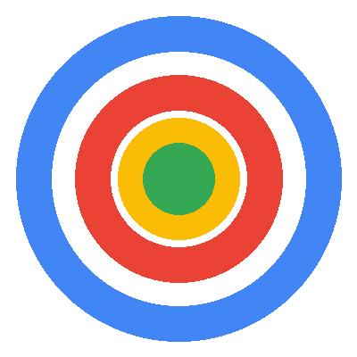
Specialist Focus
Dental & Aesthetics PPC
DRIVING PATIENT ACQUISITION
Direct experience managing campaigns for dental clinics and cosmetic practices
16 Years
100+
£50M+
Dental by Design | Prodent Group
Hands-On Google Ads
Accounts Managed
Total Spend
Christopher Hoole
Google Ads Specialist | April 2026
christopherhoole.com
Performance Marketing Specialist | Interview Presentation

Slide 2
About Me
christopherhoole.com
16 Years
100+
£50M+
6 Levels
In Paid Media (Since 2009)
Accounts Managed
Total Spend Managed
ACT Optimization Engine
Key Credentials
Hands-on platform specialist — I work inside Google Ads and Meta daily. Not a strategist who delegates.
Direct dental & aesthetics PPC experience — cosmetic dental clinic (via PodDigital) and Medizen Aesthetics.
Built ACT (Ads Control Tower) — a proprietary optimization engine. 30+ automated checks across 6 levels.
This is not a strategy-only profile. Every role I've held has been hands-on, in-platform, accountable for results.
Christopher Hoole | christopherhoole.com | Confidential
2

Slide 3
Relevant Experience — Dental & Aesthetics
Competitive B2C Lead Gen
Direct experience in the same market dynamics as Dental by Design
Cosmetic Dental Clinic (via PodDigital)
Medizen Aesthetics (Birmingham)
Google Ads for a cosmetic dental practice — implants, veneers, cosmetic treatments
Generated patient enquiries in a competitive local market with high CPCs (£5-15+)
Full search campaign management, bid strategy optimization, negative keyword framework
Confidential — active agency client (can discuss approach and results in conversation)
Medically-led cosmetic clinic — injectable treatments, laser procedures, aesthetic services
High-value patient leads in a competitive B2C market
Search-led campaigns targeting treatment-specific intent
Focus on lead quality over volume — CPA reduction through audience and landing page optimization
Why This Matters for Dental by Design
Same Patient Journey
Same Cost Dynamics
Same Success Metrics
Search intent → ad click → landing page → enquiry → booking. I know what converts.
High CPCs (£5-15+), long decision cycle, price-sensitive patients. Every wasted click is expensive.
Patient enquiries that convert to bookings — not clicks or impressions. Quality over volume.
Christopher Hoole | christopherhoole.com | Confidential
3

Slide 4
Case Study — Account Audit & Turnaround
Anonymised Client
A UK professional services business — the methodology I would apply to your account
42.7%
£20-25
of budget wasted — £7,836 of £18,338 total spend identified as waste
Target CPA achieved (down from £38) — a 35-48% reduction in cost per lead
Issue Found | Impact
No target CPA set | Algorithm spending unchecked — CPA peaked at £65
Conversion tracking inflated | Micro-conversions counted as leads — misleading bidding
Quality Scores of 2-3 / 10 | Paying 2-4x premium on every click
What I Recommended
Set proper target CPA — gave the algorithm a cost guardrail it never had
Negative keyword framework — 9 organised lists blocking wasted spend
Campaign restructure by service type — tighter ad groups, better Quality Scores
This is exactly the audit I would run on your Google Ads and Meta accounts in week 1. Same methodology, same rigour, same focus on measurable results.
Christopher Hoole | christopherhoole.com | Confidential
4

Slide 5
My Approach — Week 1 at Dental by Design
First 5 Days
Days 1-2
Days 3-4
Day 5
Full Account Audit
Competitive Landscape
Quick Wins — Live
Deep-dive into Google Ads + Meta account structure
Audit bid strategies, conversion tracking, Quality Scores
Benchmark CPL, CPA, conversion rates per clinic
Research competitor bidding — keywords, ad copy, landing pages
Identify gaps in the dental implant keyword space
Assess your USP positioning vs competitors
Fix conversion tracking issues found in audit
Add negative keywords to block wasted spend
Set proper target CPA / ROAS guardrails
Deliverable: Full audit report by end of week 1
Findings, quick wins implemented, and a 90-day optimization roadmap — delivered before you've finished onboarding with any other candidate.
Christopher Hoole | christopherhoole.com | Confidential
5

Slide 6
Months 1-3 Roadmap
90-Day Plan
20-30% CPL Reduction
Within 90 days, based on experience with similar dental and aesthetics accounts
Month 1
Month 2
Month 3
Foundation & Restructure
Optimise & Expand
Scale & Benchmark
Restructure campaigns by treatment type (implants, cosmetic, general)
Launch negative keyword framework — 9 shared lists per account
Fix conversion tracking — count real patient leads only
Landing page analysis + conversion rate optimization
Expand keyword coverage from search term mining
Begin multi-clinic rollout — adapt messaging per practice
Scale winners, cut underperformers — performance-based budget allocation
Establish benchmarks per clinic (CPL, CVR, CPA)
Full reporting framework + strategic roadmap for months 4-6
Christopher Hoole | christopherhoole.com | Confidential
6

Slide 7
Your Competitive Advantage
Market Analysis
How your integrated model creates a significant PPC advantage
Integrated Model — Clinic + Lab + Manufacturer — control over quality AND pricing. No other London competitor can match this.
"Up to 60% Less" — A powerful ad copy hook for price-sensitive patients. They click for the price, they stay for the quality.
Vivo Bridge — 48 Hours — "Permanent teeth in 48 hours" is an incredible USP. Speed + quality + price = unbeatable value proposition.
4.8★ Rating / 399+ Reviews — Social proof in ad extensions and landing pages dramatically improves click-through and conversion rates.
Multi-Clinic Network — Scale advantage — every insight from Dental by Design benefits your partner clinics nationwide.
I would leverage every one of these advantages in your ad copy, landing pages, and campaign structure.
Christopher Hoole | christopherhoole.com | Confidential
7

Slide 8
Multi-Clinic Campaign Management
Network Strategy
How I would structure campaigns for Dental by Design + your partner clinics
Element | Approach
Campaign structure | Separate campaigns per clinic — tailored messaging, budgets, targeting
Ad group structure | Treatment-level groups (Implants, Cosmetic, General, Emergency)
Negative keywords | 9 shared lists by word count + match type. One block benefits all clinics.
Reporting | Centralised dashboard with clinic-level breakdown
Budget allocation | Performance-based — best clinics earn more budget
The Network Effect
Each clinic gets individual attention, but benefits from the collective data. When one clinic discovers a winning angle — it gets rolled out across the network.
Shared Learnings
Dental by Design generates the most data — it becomes the testing ground. Proven strategies then scale to partner clinics.
Indicative KPI Targets
20-30%
Baseline →
Weekly
CPL Reduction (90 days)
Clinic Benchmarks (Month 3)
Reporting Cadence
Christopher Hoole | christopherhoole.com | Confidential
8

Slide 9
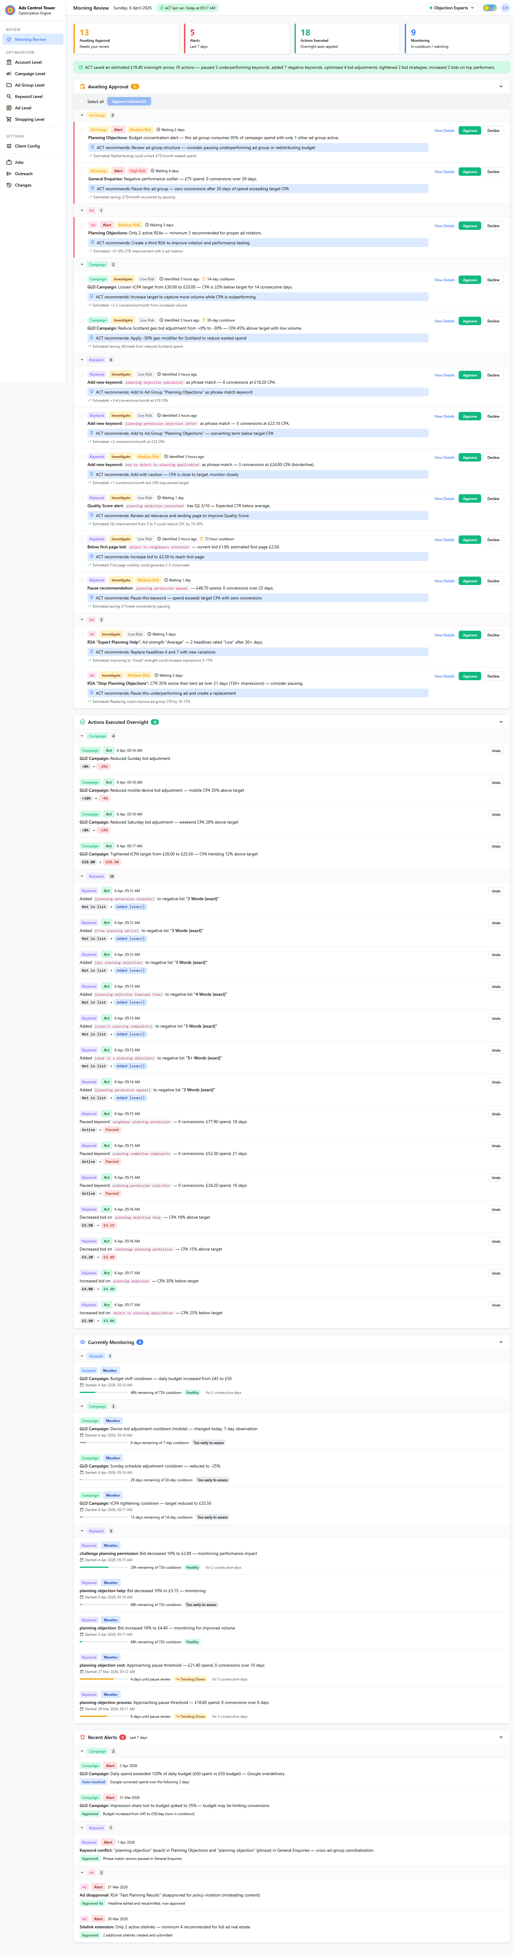
ACT — My Competitive Edge
Proprietary Platform
A proprietary Google Ads optimization engine I built from the ground up
What ACT Does
ACT Morning Review Dashboard
30+ automated checks — running overnight across all campaign elements
6 optimization levels — Account, Campaign, Ad Group, Keyword, Ad, Shopping
7 bid strategy rule sets — Manual CPC, tCPA, tROAS, Max Conv, Max Clicks, PMax, Shopping
Negative keyword engine — Auto-sorts into 9 standardised lists by word count + match type
Morning review dashboard — Shows exactly what needs attention — nothing gets missed
Human-in-the-loop — Every action logged, explainable, and reversible
"I don't just manage campaigns — I've built a system that continuously optimises them. Your campaigns are being refined 24/7, not just when I log in."
Christopher Hoole | christopherhoole.com | Confidential
9

Slide 10
Why Me
Summary
1
Hands-On Specialist — Direct access to the person making decisions. No juniors, no delegation.
2
Direct Dental & Aesthetics PPC Experience — I've managed campaigns for cosmetic dental clinics and aesthetic practices.
3
Proprietary Optimization Platform (ACT) — No other candidate has built their own Google Ads optimization engine.
4
Proven Audit Methodology — 42.7% waste identified, CPA reduced by 35-48%. Same process I'd run on your account.
5
Results-Focused Commercial Thinking — I measure success by patient bookings, not clicks. Your integrated model is an advantage I know how to use.
Christopher Hoole | christopherhoole.com | Confidential
10

Slide 11
Ready to Start Immediately
Christopher Hoole
NEXT STEPS
chris@christopherhoole.com
christopherhoole.com
+44 7999 500 184
1
Grant me access to your Google Ads and Meta accounts
Read-only access is all I need to run the full audit
16 Years
Dental PPC
ACT Engine
I'll deliver a full audit report within the first week
Hands-On Experience
Direct Experience
Proprietary Platform
2
Waste analysis, structure review, and restructure plan
"I don't just manage campaigns. I've built a system to continuously optimise them. I have direct dental PPC experience. And I'm ready to start immediately." — Christopher Hoole
3
You'll see measurable improvements within 30 days
Quick wins in week 1, structured optimization months 1-3

